Slide 1
Monitoring and Observability
Pravin Y Pawar
Adapted from Monitoring and Observability
by Cindy Sridharan

Slide 2
Only half joking – Monitoring to Observability
Why call it monitoring? That’s not sexy enough anymore.
Observability, because rebranding Ops as DevOps wasn’t bad enough,
now they’re devopsifying monitoring too!
Is that supposed to be like the second coming of DevOps? Or was it the Second Way?
It all felt so cultish anyway.
What is the difference between “monitoring” and “observability”, if any?
Or is the latter just the latest buzzword on the block,
to be flogged and shoved down throats until it has been milked for all its worth!

Slide 3
Monitoring
“Monitoring” traditionally was a preserve of Operations engineers
term often invokes not very pleasant memories in minds of many who’ve been doing it for long enough
In the eyes of many, “monitoring” harks back to many dysfunctional aspects of the old school way of operating software,
term this day causes some people to think of simple up/down checks
True that a decade ago, up/down checks might’ve been all a “monitoring” tool would have been capable of
in the recent years “monitoring” tools have evolved greatly
to the point where many, many, many people no longer think of monitoring as just external pings
While they might still call it “monitoring”,
the methods and tools they use are more powerful and streamlined

Slide 4
Whitebox monitoring
In general, tend to measure at three levels: network, machine, and application
Application metrics are usually the hardest, yet most important, of the three
Very specific to business, and they change as applications change
Time series, logs and traces are all more in vogue than ever these days
are forms of “whitebox monitoring”, which refers to a category of monitoring based on the information
derived from the internals of systems
Whitebox monitoring isn’t really a revolutionary idea anymore
at least not since Etsy published the seminal blog post introducing statsd
For all its flaws, statsd was a game changer,
most open source time series based systems as well as commercial monitoring solutions have supported statsd style metrics for years now
while not perfect, statsd style metrics collection was a huge improvement over the way one did “monitoring” previously

Slide 5
Monitoring is for symptom based Alerting
Monitoring system should address two questions: what’s broken, and why?
the “what’s broken” indicates the symptom
the “why” indicates a (possibly intermediate) cause
“What” versus “why” is one of the most important distinctions in writing good monitoring with maximum
signal and minimum noise
Blackbox monitoring
monitoring a system from the outside by treating it as a blackbox
is something is very good at answering the what is broken and alerting about a problem that’s already occurring (and ideally end user impacting)
Whitebox monitoring,
is fantastic for the signals that can be anticipated in advance and be on the lookout for
is for the known, hard failure modes of a system, the sort that lend themselves well toward exhibiting any deviation in a dashboardable manner, as it were.

Slide 6
“Monitorable” systems
One of the design goals while building systems should be to make it as monitorable as possible
A good example of something that needs “monitoring”
a storage server running out of disk space
a proxy server running out of file descriptors
Building “monitorable” systems requires being able to understand the failure domain of the critical
components of the system proactively!
The more mature a system, the better understood are its failure modes
Being able to entirely architect away a failure mode is the best thing one can do while building systems
The next best thing one can do is to be able to “monitor” impending failures and alert accordingly
For monitoring to be effective, it becomes salient to be able to identify
a small set of hard failure modes of a system
or a core set of metrics that can indicate the health of the system accurately

Slide 7
Monitoring data needs to actionable
In choosing what to monitor, keep the following guidelines to be considered:
The rules that catch real incidents most often should be as simple, predictable, and reliable as possible
Data collection, aggregation, and alerting configuration that is rarely exercised (e.g., less than once a quarter for some SRE
teams) should be up for removal.
Signals that are collected, but not exposed in any prebaked dashboard nor used by any alert, are candidates for removal.
When not used to directly drive alerts, monitoring data should be optimized for providing a bird’s eye view of the overall
health of a system
In the event of a failure, monitoring data should immediately be able to provide visibility into impact of the failure as well as
the effect of any fix deployed
The crucial thing to understand here is that monitoring doesn’t guarantee that failure can be completely avoided
Monitoring provides a good approximation of the health of a system, but monitoring doesn’t prevent failure entirely!
Monitoring can furnish one with a panoramic view of systems’ performance and behavior in the wild
however, does not make systems completely impregnable to failure, and that shouldn’t be its goal either

Slide 8
Monitoring vs Observability
The goals of “monitoring” and “observability” are different!
“Observability” isn’t a substitute for “monitoring” nor does it obviate the need for “monitoring”
they are complementary
“Observability” might be a fancy new term on the horizon, but it really isn’t a novel idea
Events, tracing, exception tracking are all a derivative of logs
if one has been using any of these tools, one already has some form of “observability”
In essence “observability” captures what “monitoring” doesn’t (and ideally, shouldn’t)!

Slide 9
Monitoring vs Observability(2)
“Monitoring” is best suited to report the overall health of systems
Aiming to “monitor everything” can prove to be an anti-pattern
is best limited to key business and systems metrics derived from time-series based instrumentation, known failure
modes as well as blackbox tests
“Observability”, on the other hand, aims to provide highly granular insights into the behavior of systems
along with rich context
perfect for debugging purposes
Since it’s still not possible to predict every single failure mode a system could potentially run into or predict every possible way in which a system could misbehave,
it becomes important that we build systems that can be debugged armed with evidence and not conjecture

Slide 10
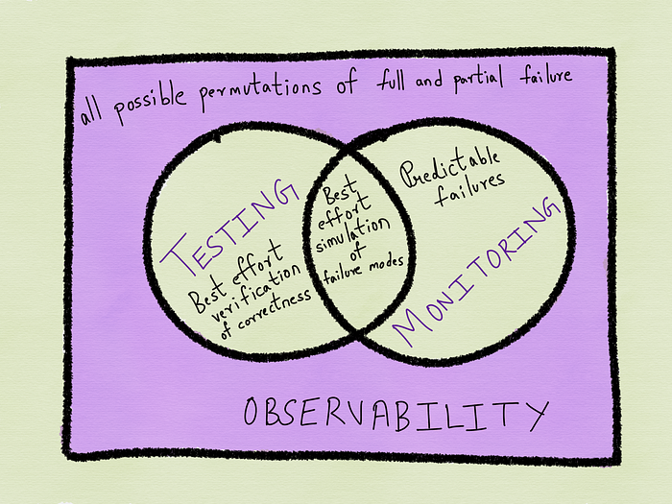
Monitoring vs Observability(3)
source

Slide 11
Observability at Twitter
Twitter has since published a two part blog post on its observability stack
The posts are more about the architecture of the different components than the term itself
These are the four pillars of the Observability Engineering team’s charter:
Monitoring
Alerting/visualization
Distributed systems tracing infrastructure
Log aggregation/analytics
“Observability”, according to this definition, is a superset of “monitoring”,
providing certain benefits and insights that “monitoring” tools provides

Slide 12
Thank You!
In our next session:

